Slide 1


Green Pace
Security Policy Presentation
Developer: Carla Melendez

Slide 2
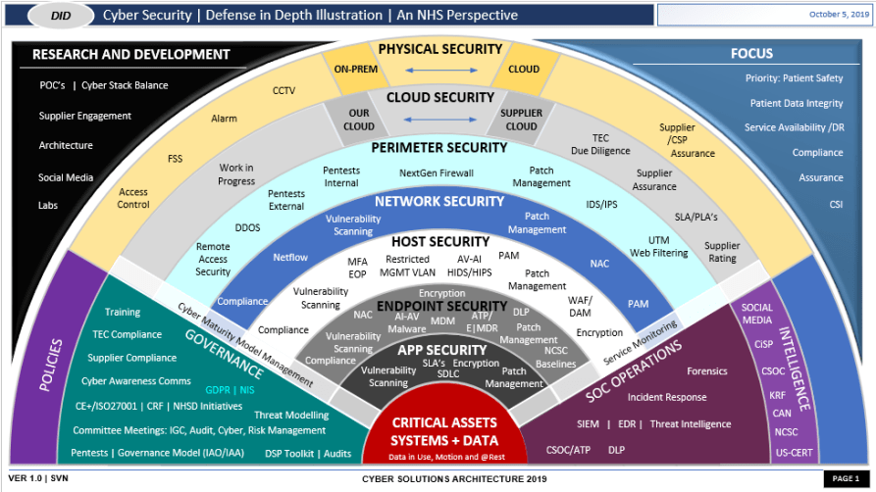
OVERVIEW: DEFENSE IN DEPTH
* Protects data if one layer fails
Notes:
In today’s digital environment, relying on a single layer of security is no longer enough. That’s why this security policy was created, to provide multiple layers of defense that work together to protect critical data and systems. This approach, known as defense-in-depth, ensures that if one layer fails, additional layers are in place to stop or slow an attack.
Our policy supports defense-in-depth by addressing risks at every level, from user access and application security to network safeguards and data encryption. By combining these protections, we create a stronger, more resilient system that not only meets compliance requirements but also reduces the likelihood of vulnerabilities being exploited.

Slide 3
THREATS MATRIX
Likely Weak Input validation (SQL injection, buffer overflow) | Priority Unauthorized access (weak authentication, privilege escalation)
Low priority Comment clarity issues, inconsistent naming conventions | Unlikely Hardware failure, physical access breach
[Populate the Threats Matrix table and provide explanations to summarize of all of your security risks.]
Notes:
This threats matrix outlines the main security risks we need to address:
Likely category – One of the most common issues is weak input validation, which can lead to injection attacks or buffer overflows. Since these are easy to exploit, they pose a constant threat
Priority category – The highest concern is unauthorized access. This could happen through weak authentication or privilege escalation, which could expose sensitive data and critical systems
Low-priority category – I included risks such as poor comment clarity or inconsistent naming conventions. While these don’t directly cause breaches they make code harder to maintain and can introduce human errors over time
Unlikely category – This includes risks like hardware failure or physical access breaches. These are still important but occur less often and are usually mitigated through redundancy and physical security controls

Slide 4
10 PRINCIPLES
Principle 1- Validate input: Standards: Data type, Bounds checking
Principle 2- Handle errors securely: Standards: Custom exceptions, Null checks
Principle 3- Least Privilege: Standards: Access control, Authorization checks
Principle 4- Keep Security Simple: Standards: Comment clarity, Consistent coding style
Principle 5- Defense in Depth: Standards: Multiple validation layers, Encryption in flight/at rest
Principle 6- Fail Securely: Standards: Exception handling, Secure defaults
Principle 7- Don’t trust External Sources: Standards: Input validation, Sanitize external data
Principle 8- Secure Data Storage: Standards: Encryption at rest, Null checks on sensitive values
Principle 9- Separate Duties: Standards: Role-based access, Authentication checks
Principle 10-Promote Code Quality: Standards: Unit testing, Static analysis, Comment clarity
Notes:
These ten secure coding principles align with the standards we’ve applied.
Input validation connects to data type checks and bounds checking, protecting against injection and overflow. Handling errors securely uses exceptions and null checks to avoid leaking information.
Least privilege works with authorization controls, and keeping security simple ties to clear code and documentation. Defense in depth relies on layered validation and encryption, while failing securely emphasizes proper defaults and exception handling.
Not trusting external sources requires sanitizing all inputs. Secure data storage focuses on encryption at rest. Separating duties uses role-based access, and promoting code quality relies on unit testing and static analysis.

Slide 5
CODING STANDARDS
Priority Order of Coding Standards:
1. Data type checks
2. Bounds checking
3. Null checks
4. Input Validation
5. Custom exceptions
6. Encryption
7. Access control/ authorization
8. Unit testing
9. Static analysis
10. Comment clarity
Notes:
Here are the ten coding standards prioritized by risk.
First, data type checks, bounds checking, and null checks come first since memory safety issues can cause crashes and vulnerabilities. Next is input validation, which prevents injection attacks.
Custom exceptions are ranked high to ensure secure error handling. Encryption is critical for protecting sensitive data both in storage and transmission.
Access control follows, since weak authorization can expose entire systems. Unit testing and static analysis are important for maintaining quality and catching errors early. Finally, comment clarity is ranked lowest, while still useful, it impacts maintainability more than security.

Slide 6
ENCRYPTION POLICIES
Encryption in Flight -> TLS/SSL for secure data transfer
Encryption at rest -> AES-256 for stored data
Encryption in Use -> Secure memory handling, encrypted sessions
Notes:
Our encryption strategy covers data in all states.
For encryption in flight, we use TLS and SSL to secure communications and prevent interception during transmission.
For encryption at rest, sensitive data is stored using strong algorithms such as AES-256 to ensure protection if storage media is compromised.
Finally, for encryption in use, we focus on secure memory handling and encrypted sessions to safeguard data that is actively being processed.
By applying encryption at every stage, we protect data end-to-end.

Slide 7
TRIPLE-A POLICIES
Authentication -> MFA, strong password policies
Authorization -> Role-based access control (RBAC)
Accounting -> System logging and audit trails
Notes:
Our Triple-A policies strength system security
For authentication, we require multi-factor authentication and enforce strong password rules to verify identity
For authorization, we apply role-based access control, ensuring users only have access to what they need
For accounting, all user activity is logged, with audit trails available for monitoring and investigations
Together, these measures help ensure accountability and protect sensitive systems

Slide 8
Unit Testing
* Focused on input validation vulnerability
*4-6 mixed tests: valid & invalid input
Positive = correct results returned
Negative = system rejects invalid input
Notes:
For unit testing I focused on input validation, since its one of the most common vulnerabilities. I ran a series of positive and negative tests to confirm the system handles both valid and invalid input correctly. The following slides show examples of the test cases and results

Slide 9
Test 1 – Valid Input
Input: username = “Alice123”
Expected Result: Accepted
Actual Result: Passed
Notes:
For the first test I entered a valid username “Alice123”
The system correctly accepted the input, which shows that normal user data is being handled as expected

Slide 10
Test 2 -Invalid Input (SQL Injection)
Input: username = “admin” OR ‘1’ = ‘1’
Expected result: Rejected
Actual Result: Passed
Notes:
Next, I tested a SQL injection attempt using the input ‘admin’ or ‘1=1’
The system successfully rejected this, which confirms that the input validation is filtering out malicious code

Slide 11
Test 3- Null Input
Input: username = “”
Expected result: Rejected
Actual Result: Passed
Notes:
For the third set, I submitted an empty input
The system rejected it, which shows that null values are properly being handled instead of creating errors or vulnerabilities

Slide 12
Test 4 – Boundary test
Input: 256-character string
Expected result: Rejected
Actual result: Passed
Notes:
In this test I entered a 256-long character string, which goes beyond the allowed limit.
The system rejected the input proving that bounds checking is working correctly

Slide 13
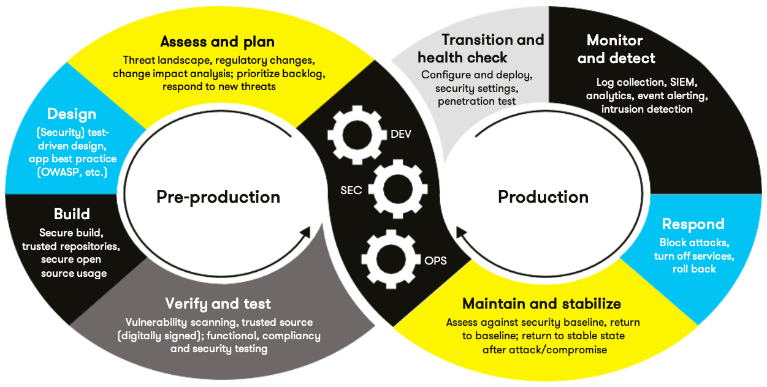
AUTOMATION SUMMARY
Automated code scans in
pre-production
Unit testing and static analysis in build stage
Monitoring and intrusion detection in production
Automated response and logging for incidents
Notes:
This slide shows how security is built into the automation pipeline
In the pre-production stage, automated code scans and threat analysis tools check for vulnerabilities before deployment
During the build stage, unit testing and static analysis tools automatically run to catch coding errors and enforce activity
In production, monitoring tools such as intrusion detection systems continuously watch for suspicious activity
Finally, automated responses and logging ensure incidents are detected and addressed quickly. By embedding these checks into every stage, security becomes part of the entire DevSecOps process

Slide 14
TOOLS
  * Pre-production -> Threat modeling, SAST tools (example SonarQube)
  Build -> Unit testing, static analyzers, dependency scanners
  Production -> Monitoring tools
  Post-production -> Automated logging, incident response platforms
Notes:
These are the main tools used in the DevSecOps pipeline
In pre-production, we use static application security testing tools like SonarQube to analyze code for vulnerabilities before it’s deployed
During the build stage, automated unit testing and dependency scanning tools check for errors and insecure libraries
In production, monitoring tools such as intrusion detection systems and SIEM platforms watch for unusual activity
Finally in post-production, automated logging and incident response platforms make sure that any issues are captured and acted on quickly
These tools help integrate security into every step of development and operations

Slide 15
RISKS AND BENEFITS
Risks if delayed:
Data breaches and financial loss
Compliance violations
System downtime
Benefits if implemented:
Stronger data protection
Reduced attack surface
Higher trust and compliance
Notes:
If security improvements are delayed, the risks include possible data breaches, financial loss, compliance violations, and even system downtime. Attackers take advantage of weak points quickly, so waiting only increases exposure
On the other hand, implementing these policies now creates immediate benefits: stronger data protection, a reduced attack surface, and compliance with industry standards. It also builds customer trust by showing that security is a priority.
Acting early ensures that security is proactive, not reactive

Slide 16
RECOMMENDATIONS
    Gaps identified:
    Limited monitoring in real-time
    Need for stronger user training
    Lack of continuous compliance checks
    Recommendations:
    Implement SIEM for advanced monitoring
    Provide ongoing security training
    Automate compliance testing
Notes:
While the security policy is strong, there are still a few areas for improvement
First, real-time monitoring could be expanded by using SIEM system to provide advanced detection and alerts
Second, user training should be ongoing since human error is often the weakest link in security
Finally, compliance checks should be automated to ensure that standards are consistently met.
By addressing these gaps, the policy becomes more proactive and resilient

Slide 17
CONCLUSIONS
Standards to Adopt:
- OWASP Top 10 for web security
NIST Cybersecurity Framework
Secure coding best practices (input validation error handling)
Continuous security testing and monitoring
Notes:
In conclusion, adopting recognized standards ensures that security remains strong over time
The OWASP Top 10 helps address the most common web application risks. The NIST Cybersecurity Framework provides structured guidelines for managing threats.
In addition, following secure coding best practices, like input validation and proper error handling, reduces vulnerabilities from the start.
Finally, continuous testing and monitoring should be built into development to catch issues early. By combining these standards, future risks can be minimized and the system stays resilient.

Slide 18
REFERENCES
OWASP Foundation. (2021). OWASP Top Ten. https://owasp.org/www-project-top-ten/
National Institue of Standards and Technology. (2018). Framework for improving critical infrastructure cybersecurity (version 1.1). http://doi.org/10.6028/NIST.CSWP.04162018
Howard, M., & LeBlanc, D. (2003). Writing secure code (2nd ed.). Microsoft Press.
Viega, J., & McGraw, G. (2021). Building secure software: How to avoid security problems the right way. Addison-Wesley.
Notes:
Here are the references I used for this project. They include industry frameworks like OWASP and NIST, as well as secure coding best practices from published works.

